Slide 1
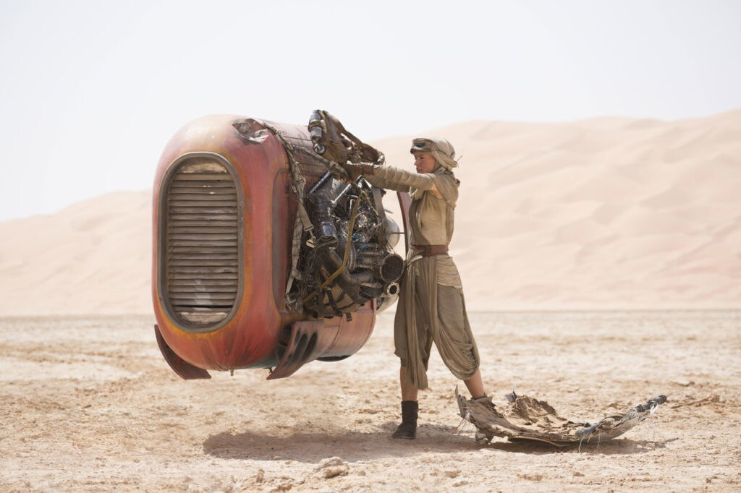

Advanced Analytics Scavenger hunt
Offsite November 2024 / Koblenz
Dennis Bakhuis
BTO-DD-ANA
Image: Star Wars – Episode 7 – the force awakens

Slide 2
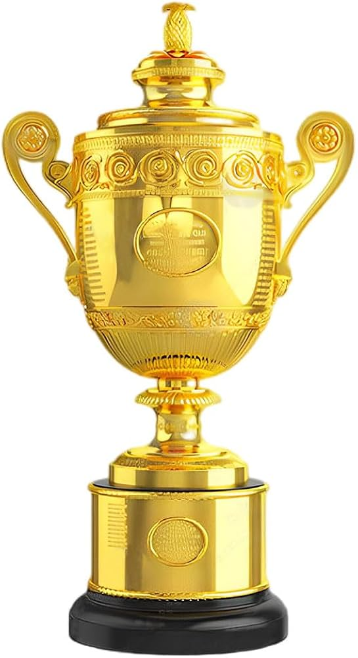
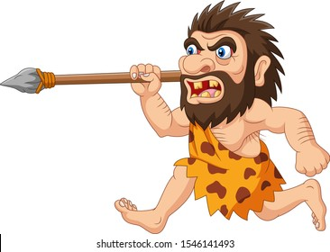


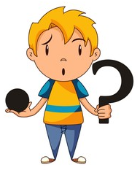


Other contestants
Scavenger what?
Hunt
Group
Location
Puzzle
Points

Slide 3

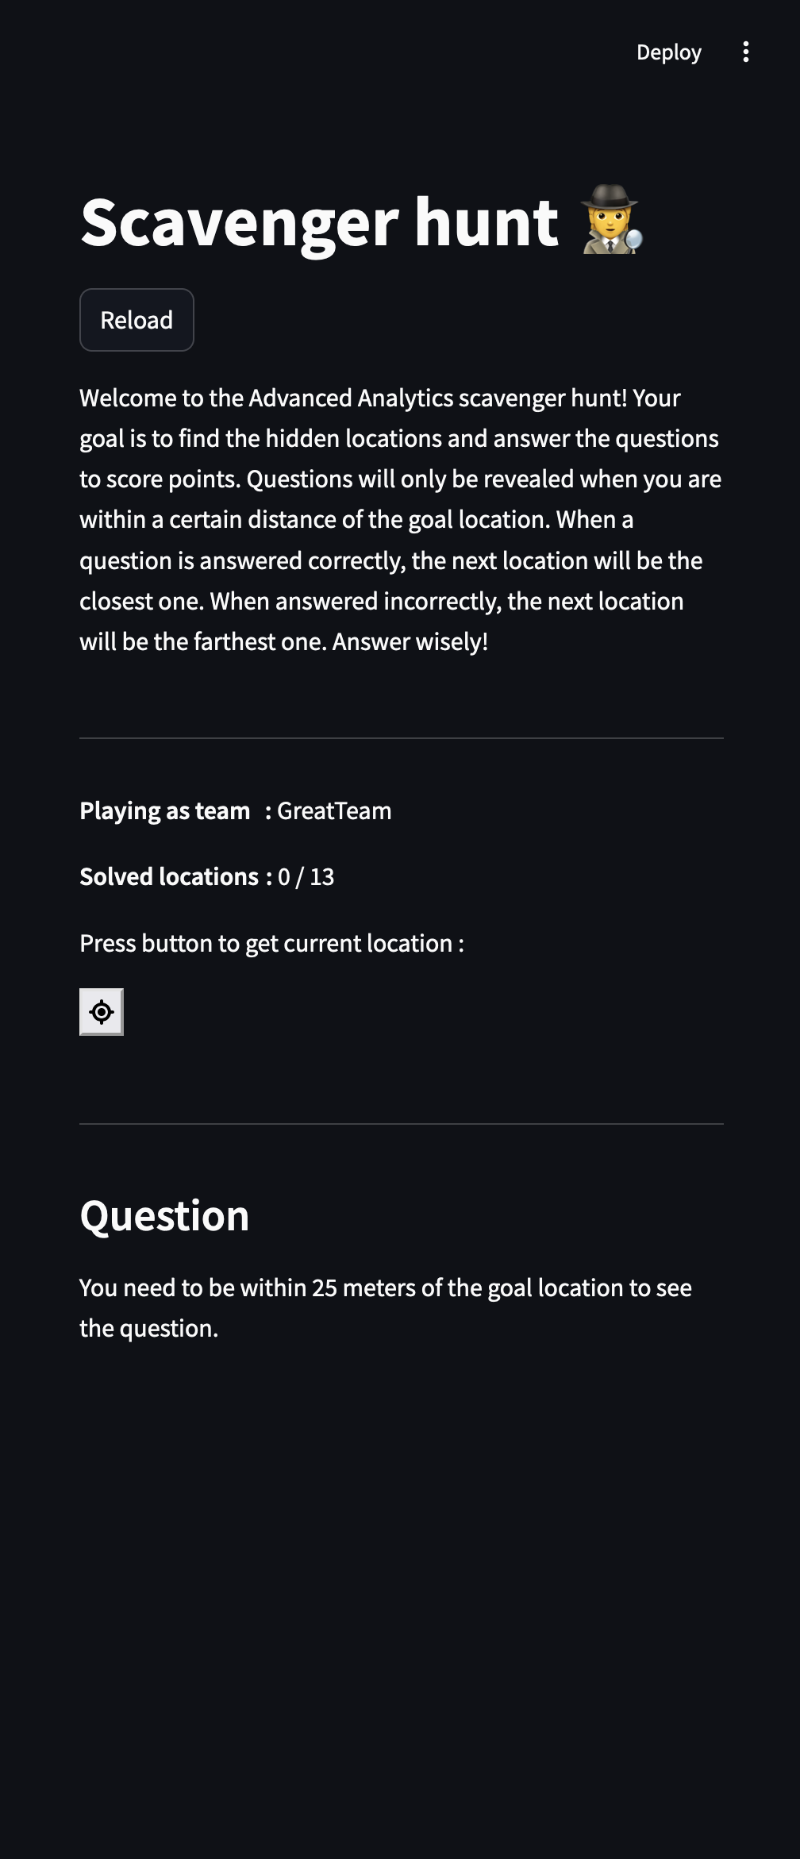
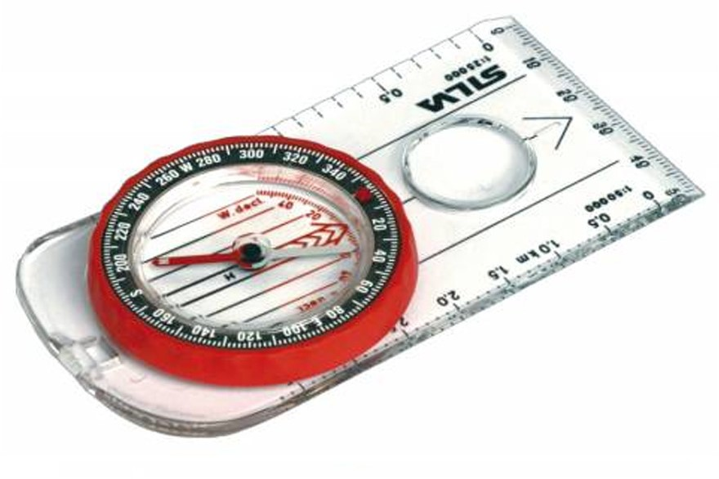
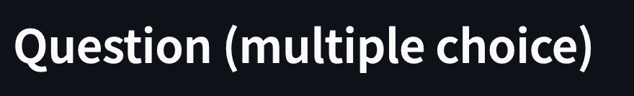

How to find a location?
Bearing + distance
25 meter
A question
Will be here
Update location
Solve
puzzle

Slide 4
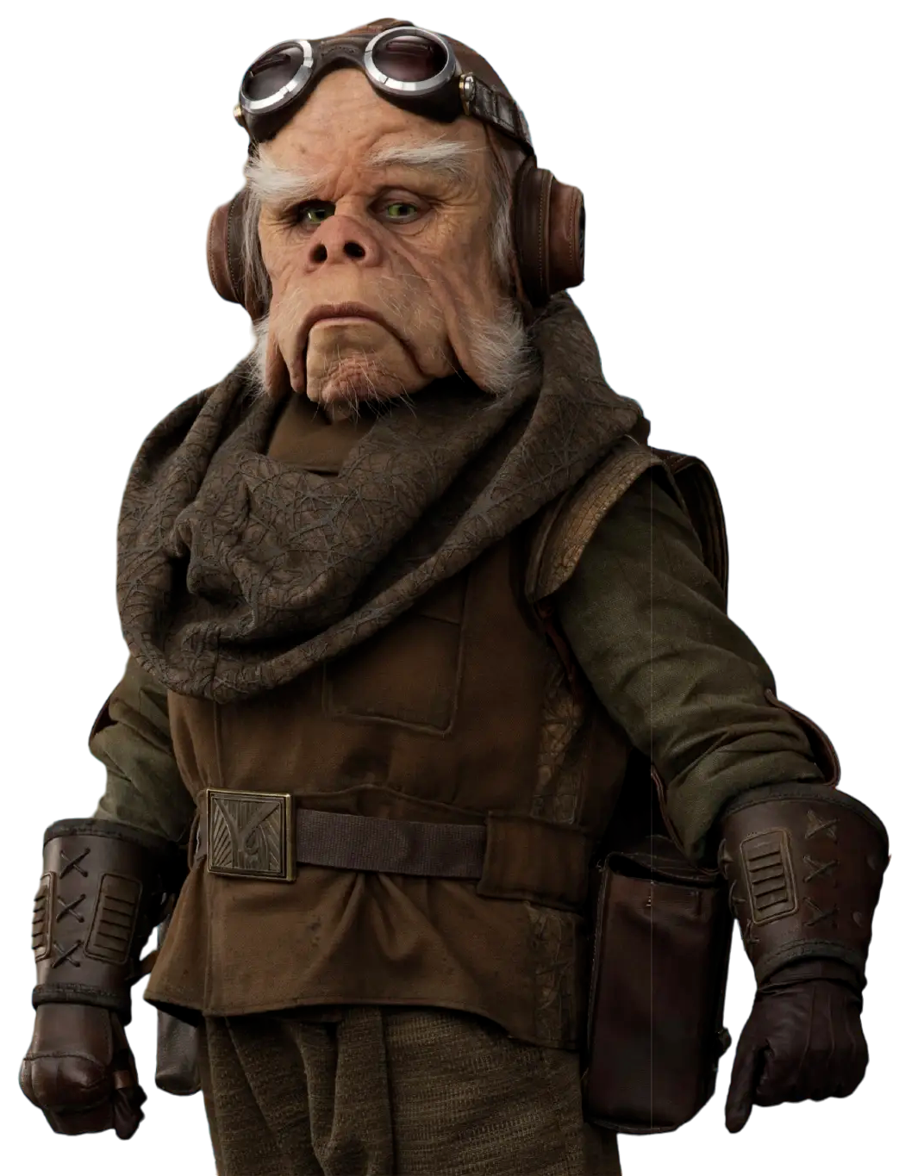
Two types of questions
Multiple choice
I don’t know
Open questions
Buttons with options
Button
Input field with submit button
If you press the button: ’you have spoken’
Correct answer : 2 points
Incorrect answer : -1 point
Don’t know / not reached : 0 points

Slide 5
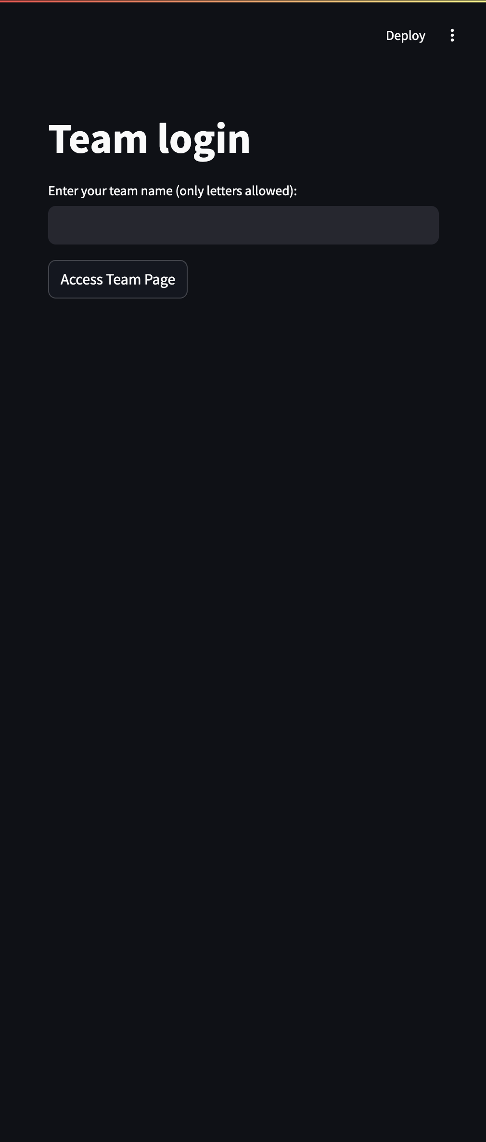
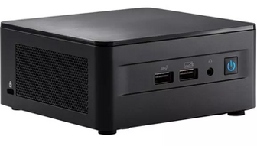
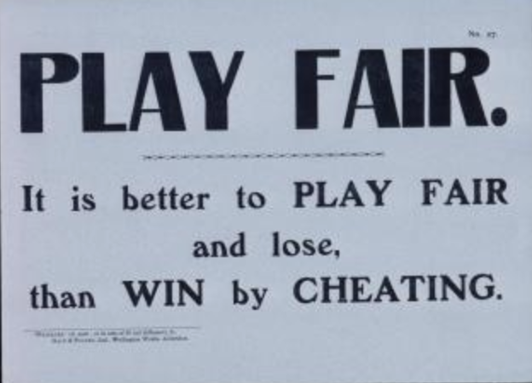
Practicalities
Login is simply a team name!
Only letters (i.e., no numbers, symbols, spaces)
Be creative, examples: `verySmart`
Only 1 device per team
🕰️ Be back at 16.40 🕰️
Try to solve puzzles on your own

Slide 6
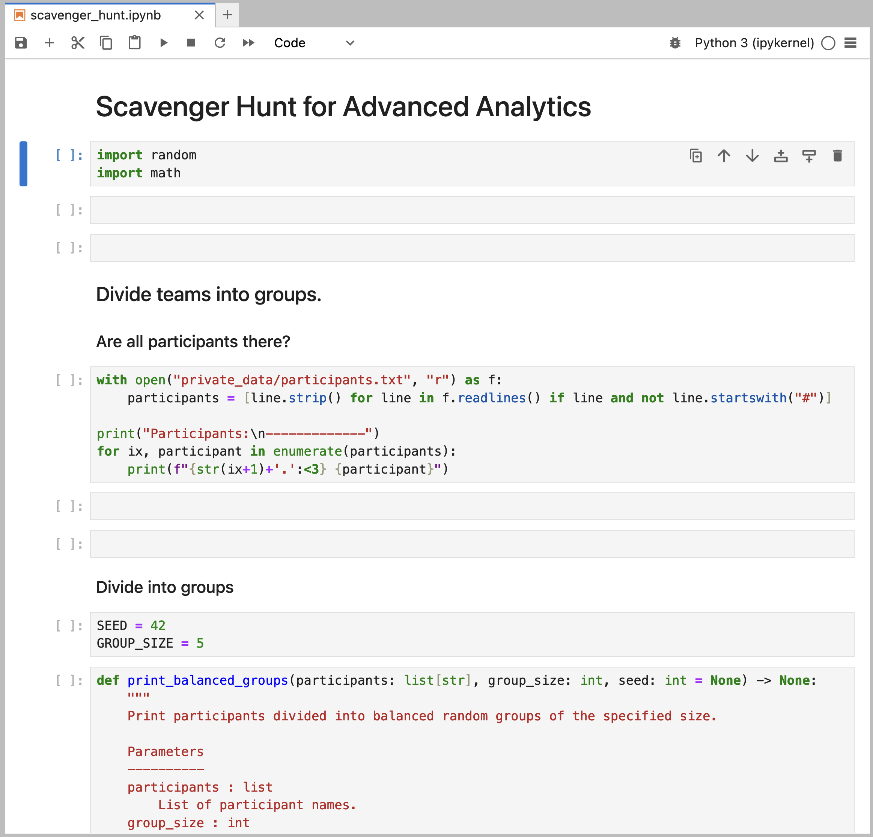
Creating teams
Let's do that on-the-fly now...

Slide 7
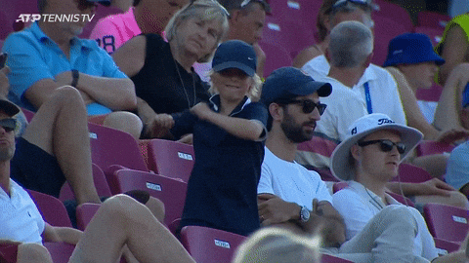
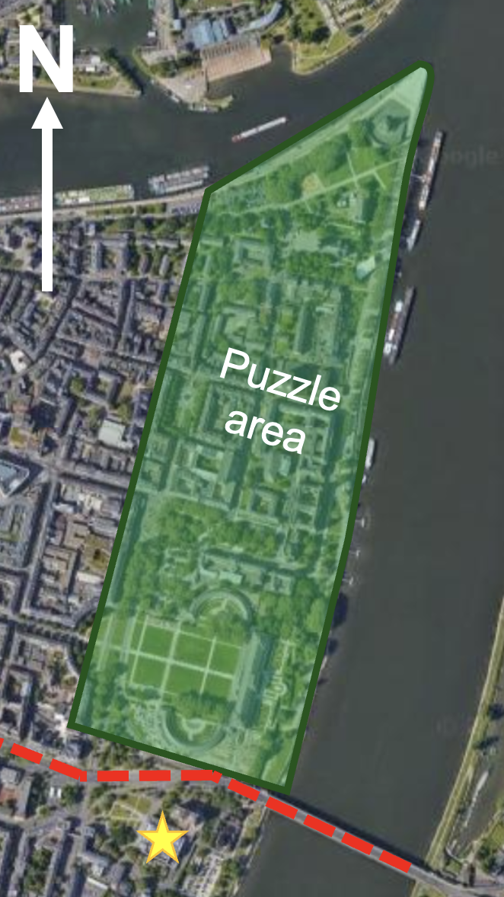
Have fun!
Questions?
🕰️ Be back at 16.40 🕰️
Only 1 device per team

Slide 10
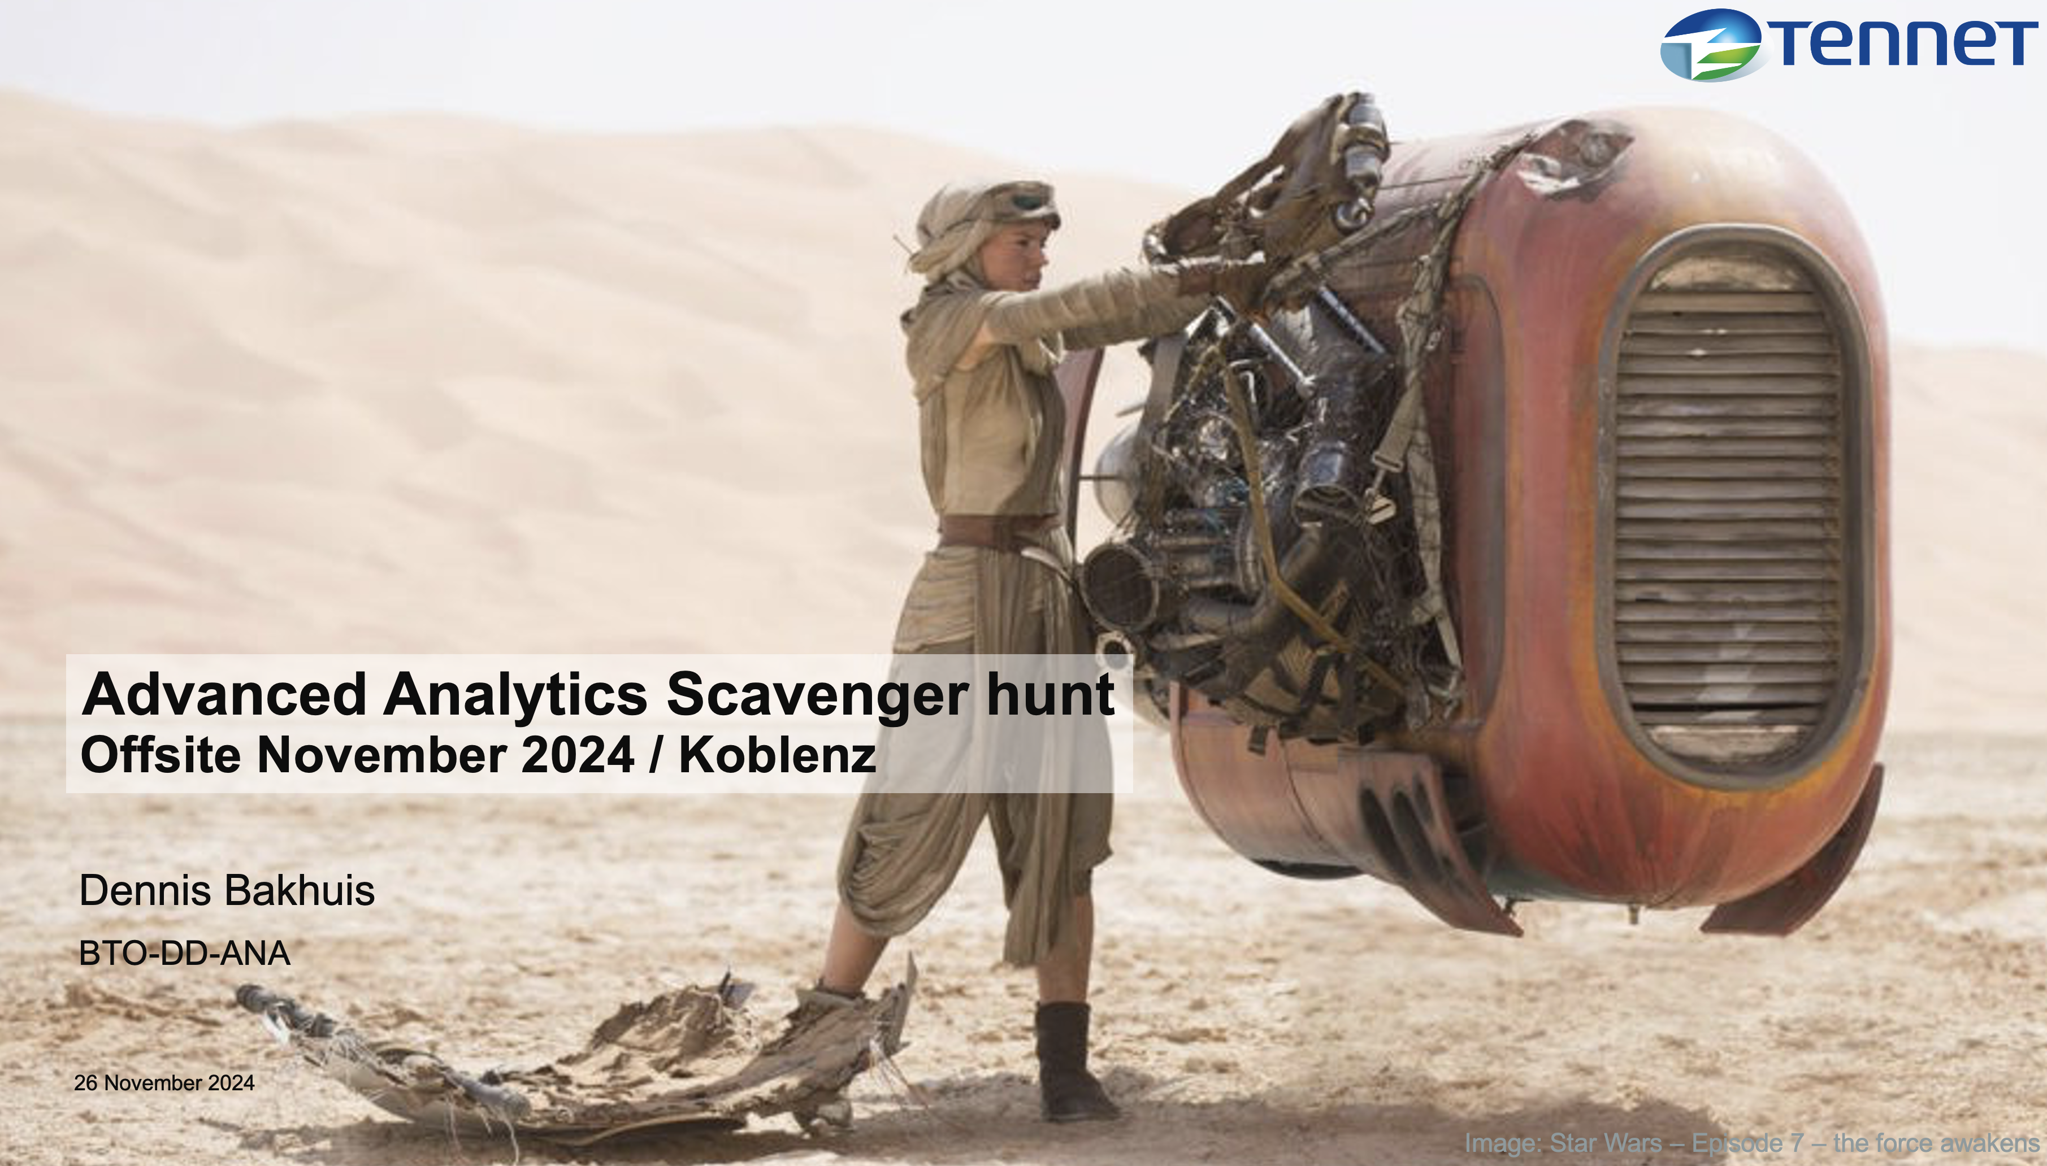
Debrief

Slide 11
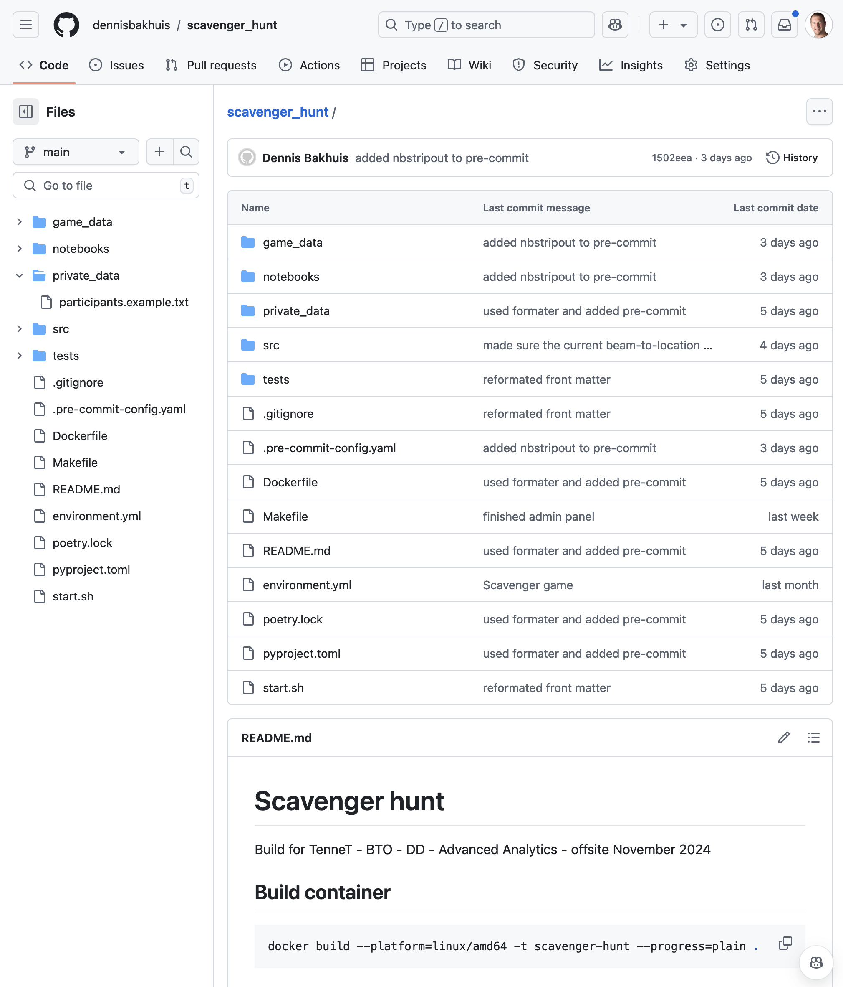
https://github.com/dennisbakhuis/scavenger_hunt
How did it go?
Groups names here…
PRs are welcome!

Slide 12

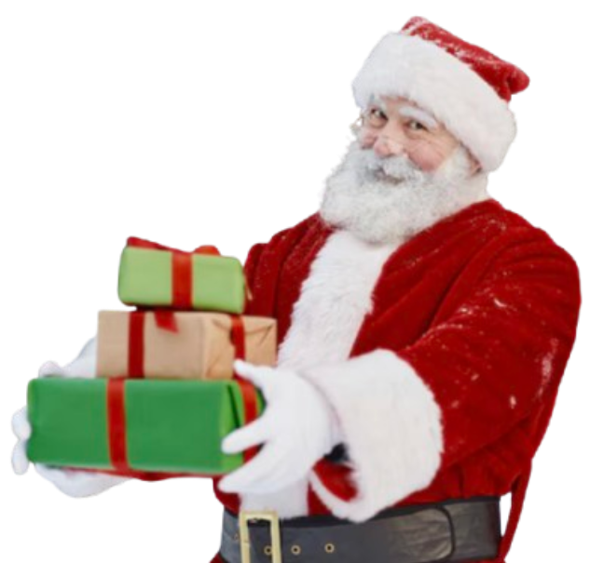
”Strooigoed” → needs to be shared!
The winner wins the distribution task

Slide 13
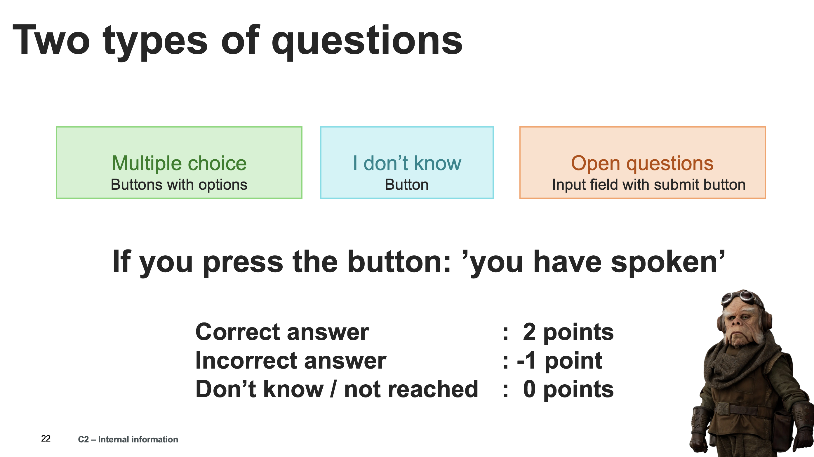
Hidden mechanic
Next goal will be the closest location
Next goal will be the furthest location
Next goal will be a random location

Slide 14
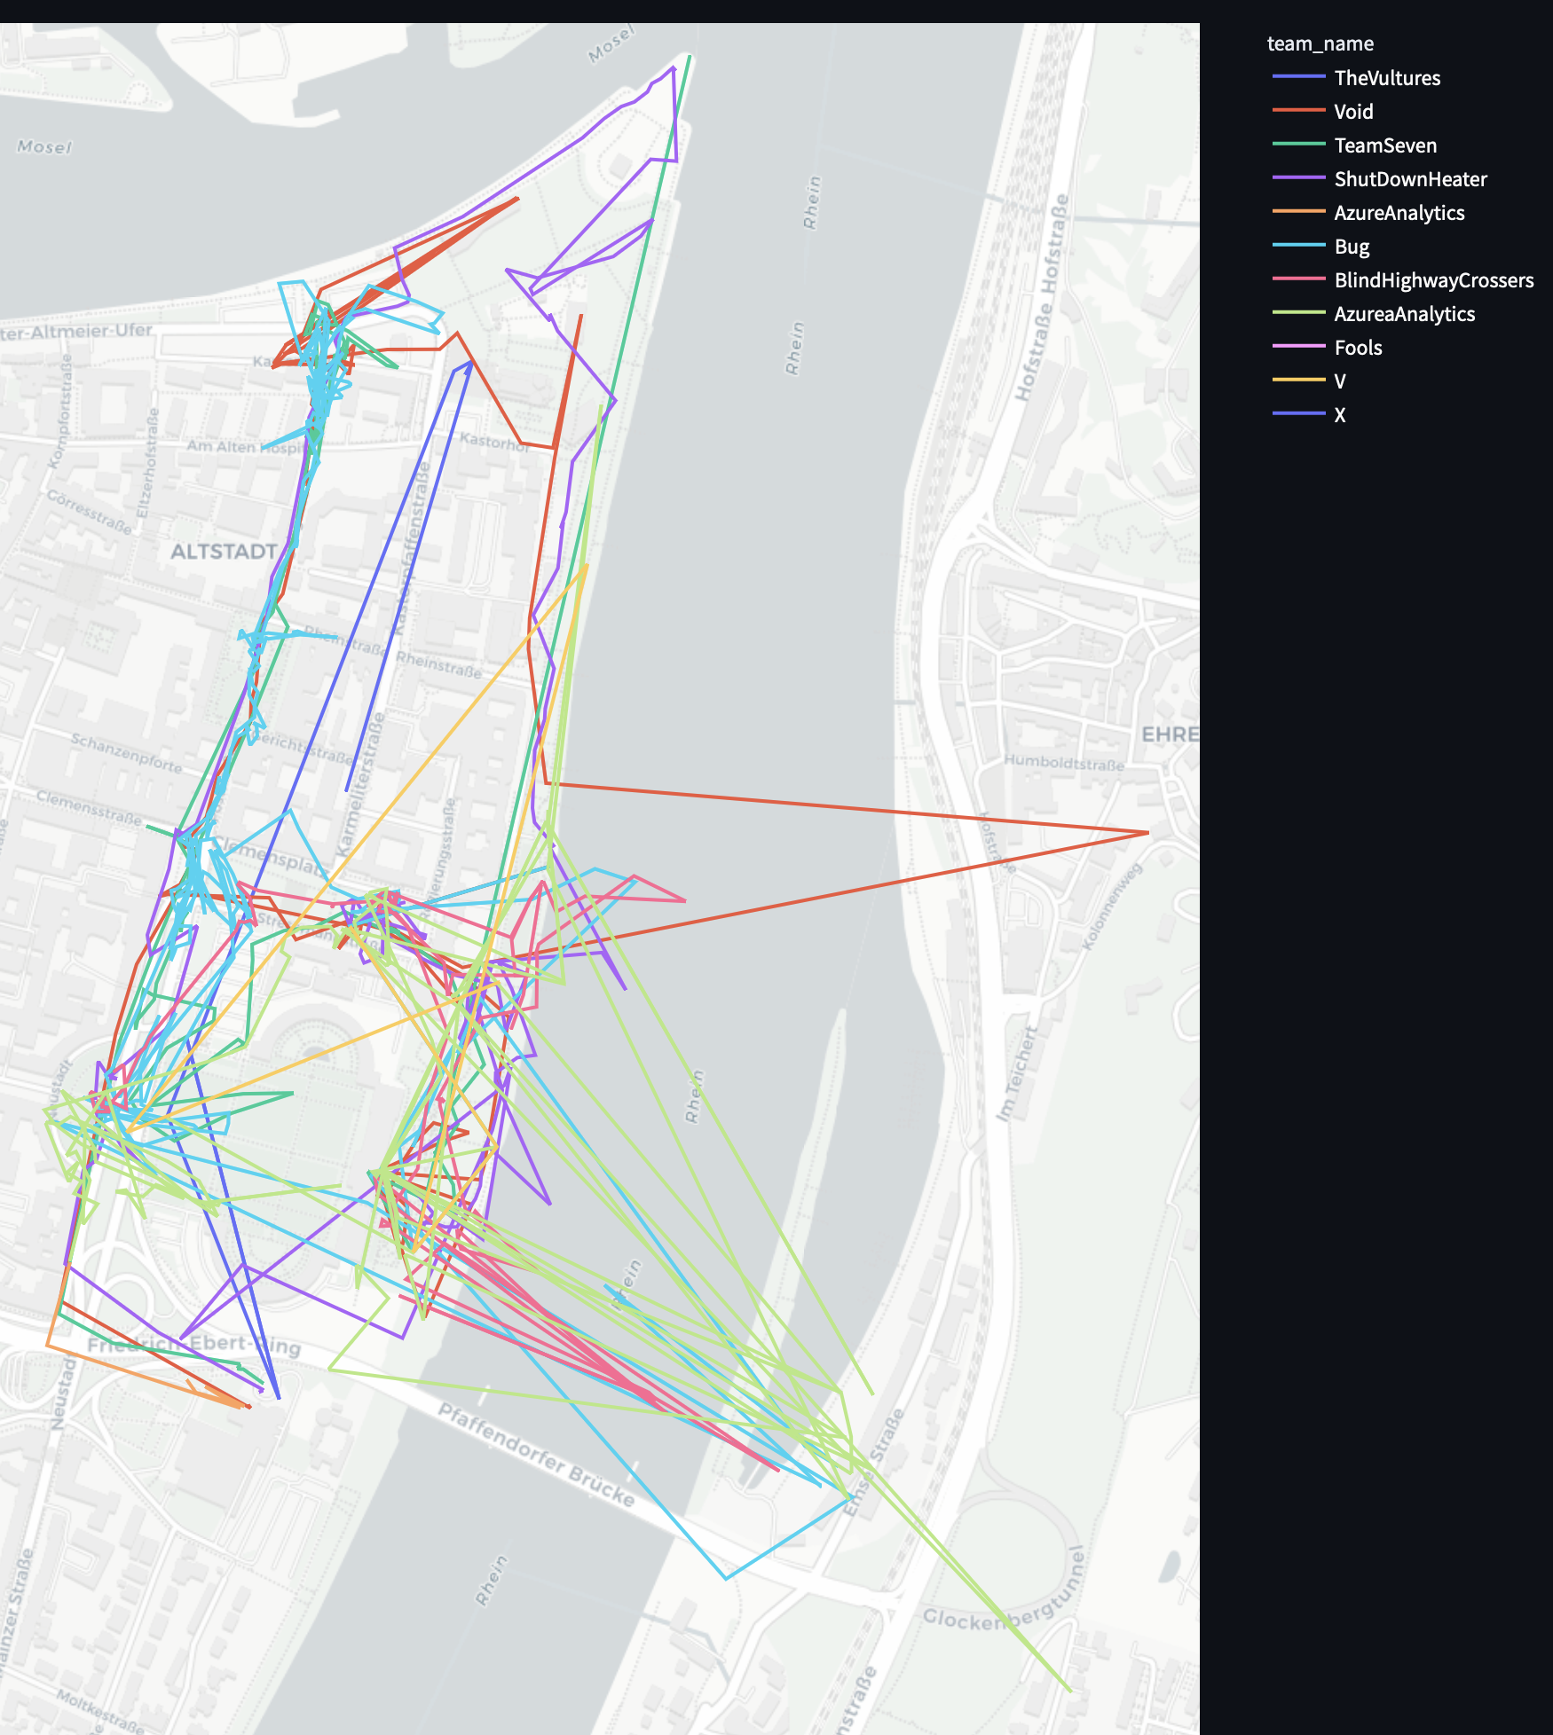
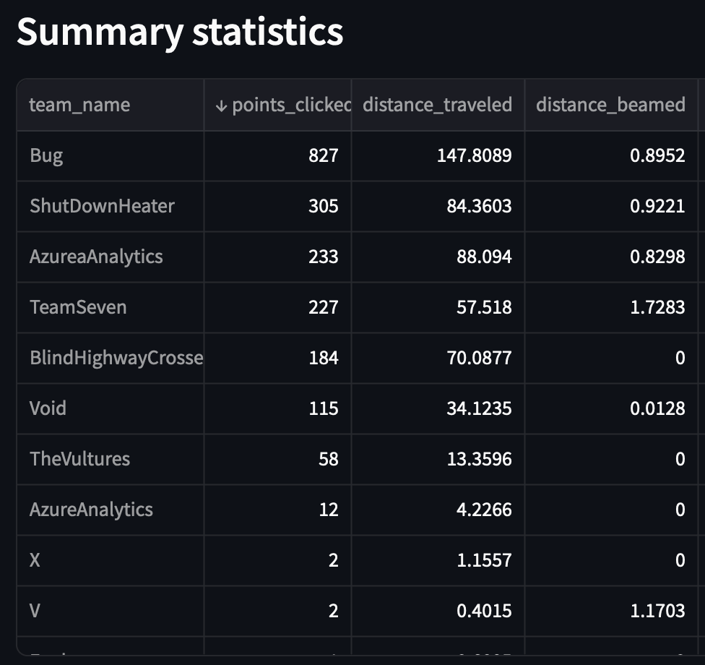
Statistics

Slide 15
Statistics

Slide 16
Solutions

Slide 17
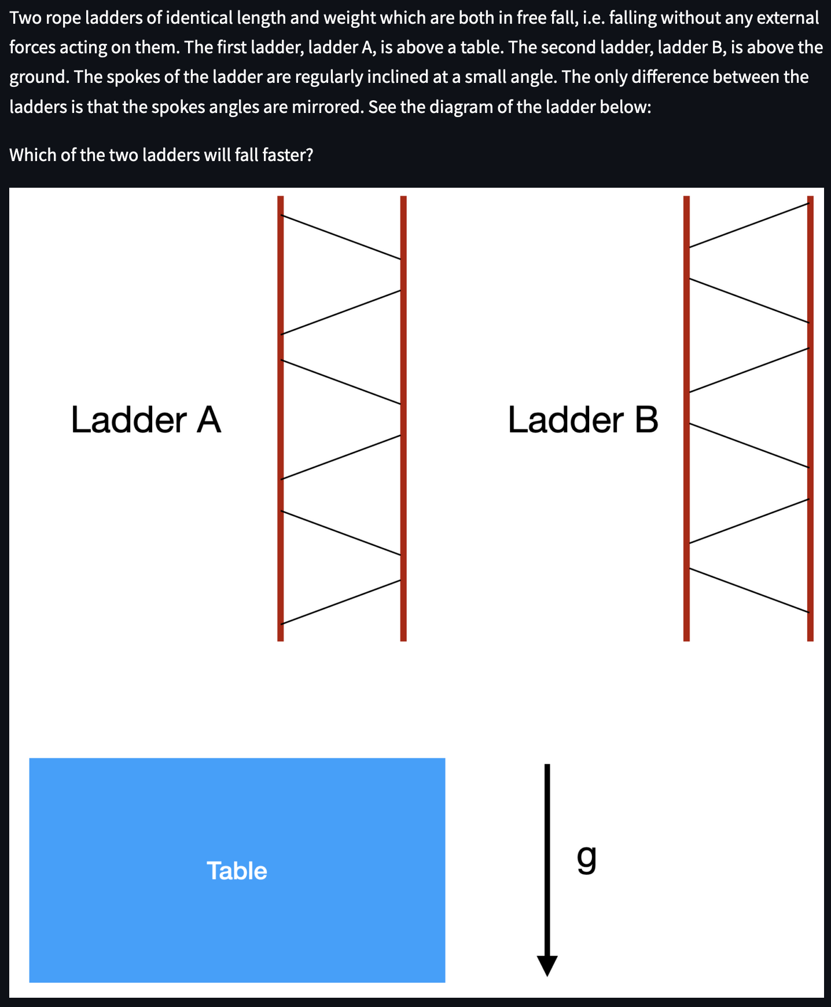
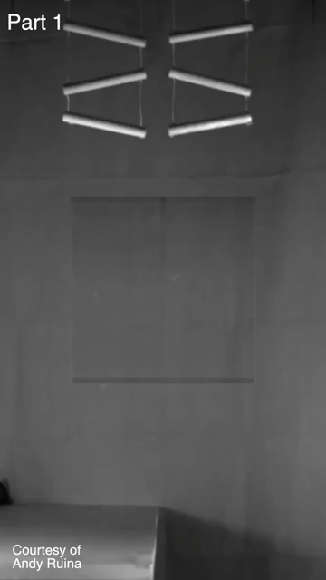
Veritasium
1. Ladders

Slide 18
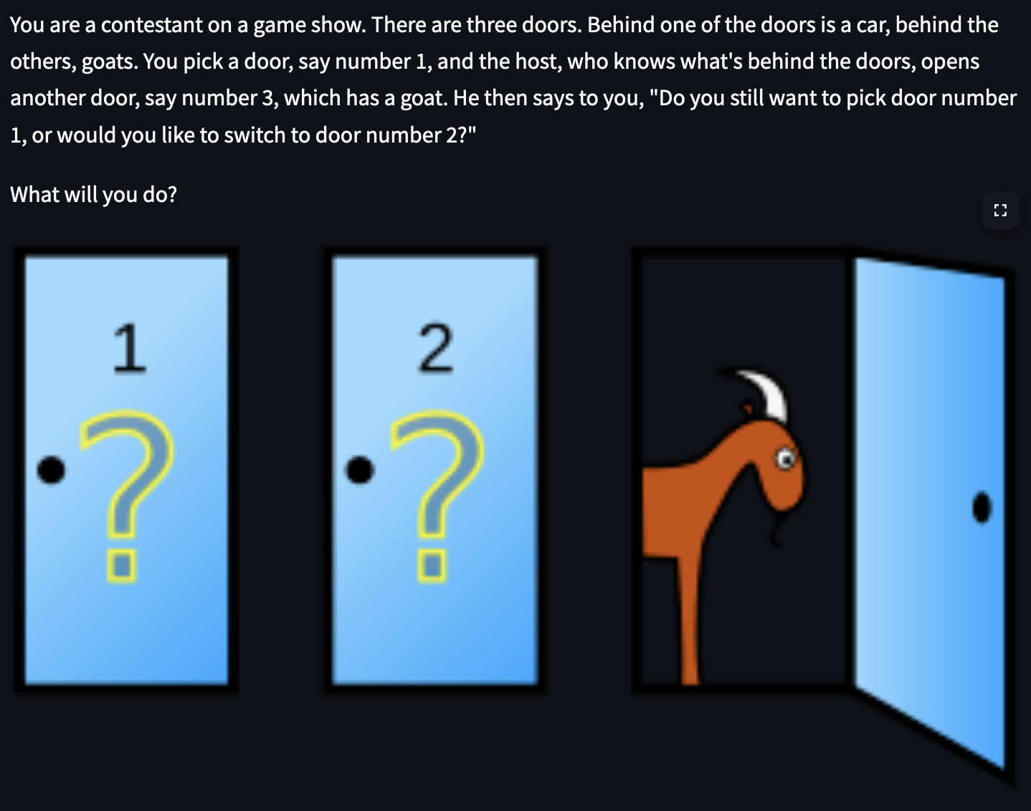
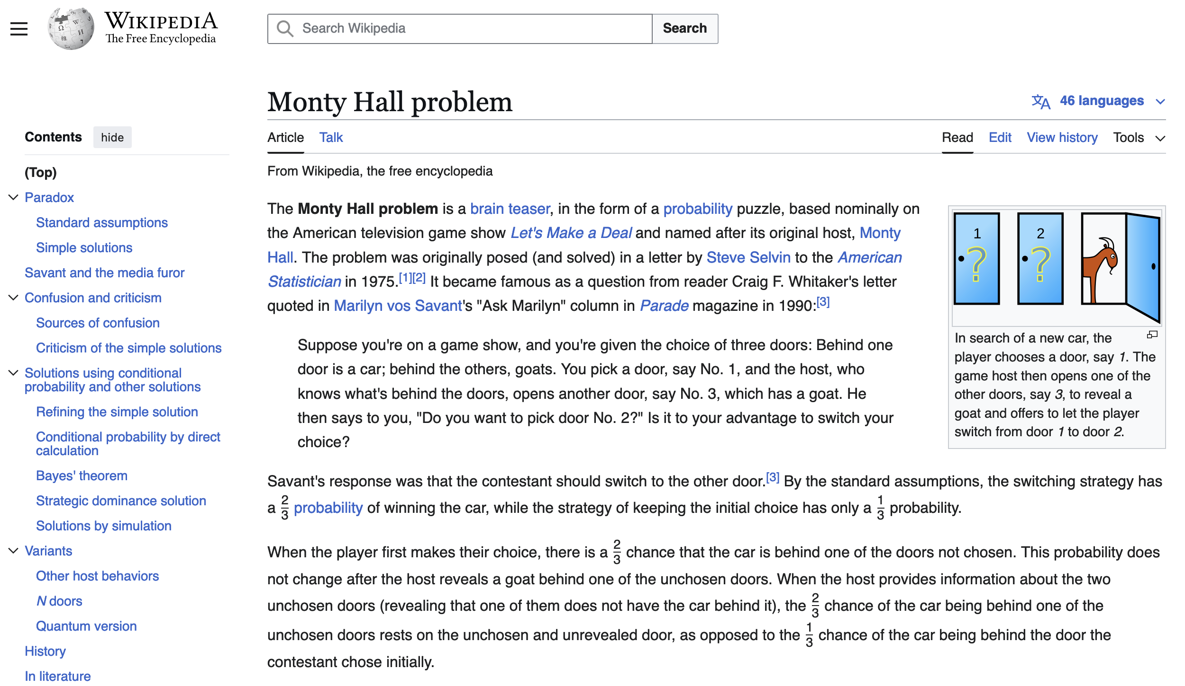
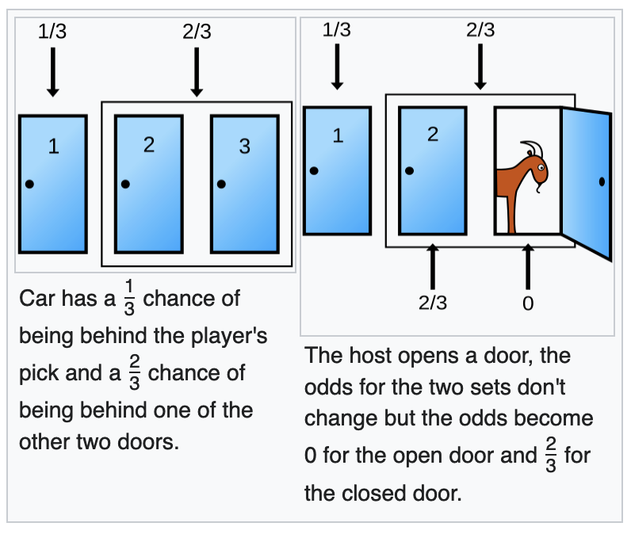
2. Three doors
Monty Hall problem

Slide 19
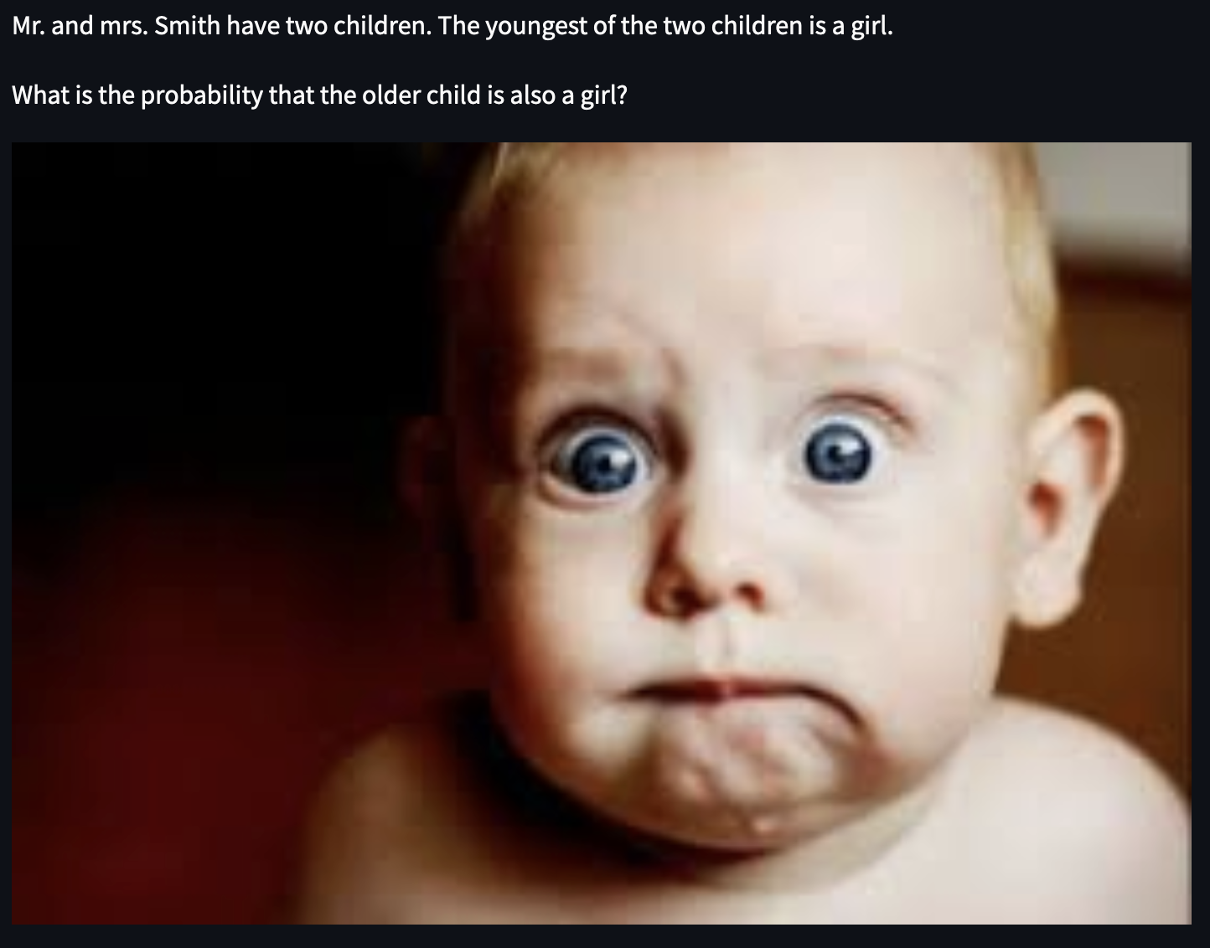
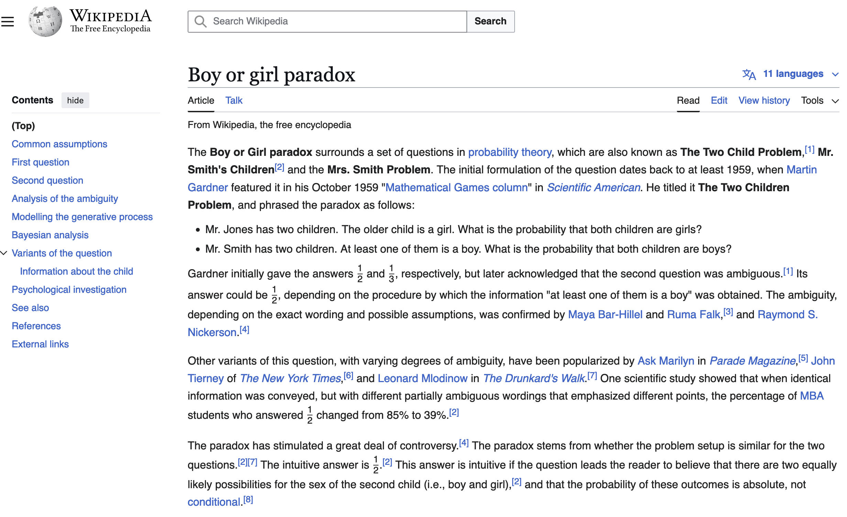
3. Two kids
Boy or girl paradox
The solution space has four options, however due to provided information, two of those are not possible. This leads to a 1 out of 2 scenario.

Slide 20
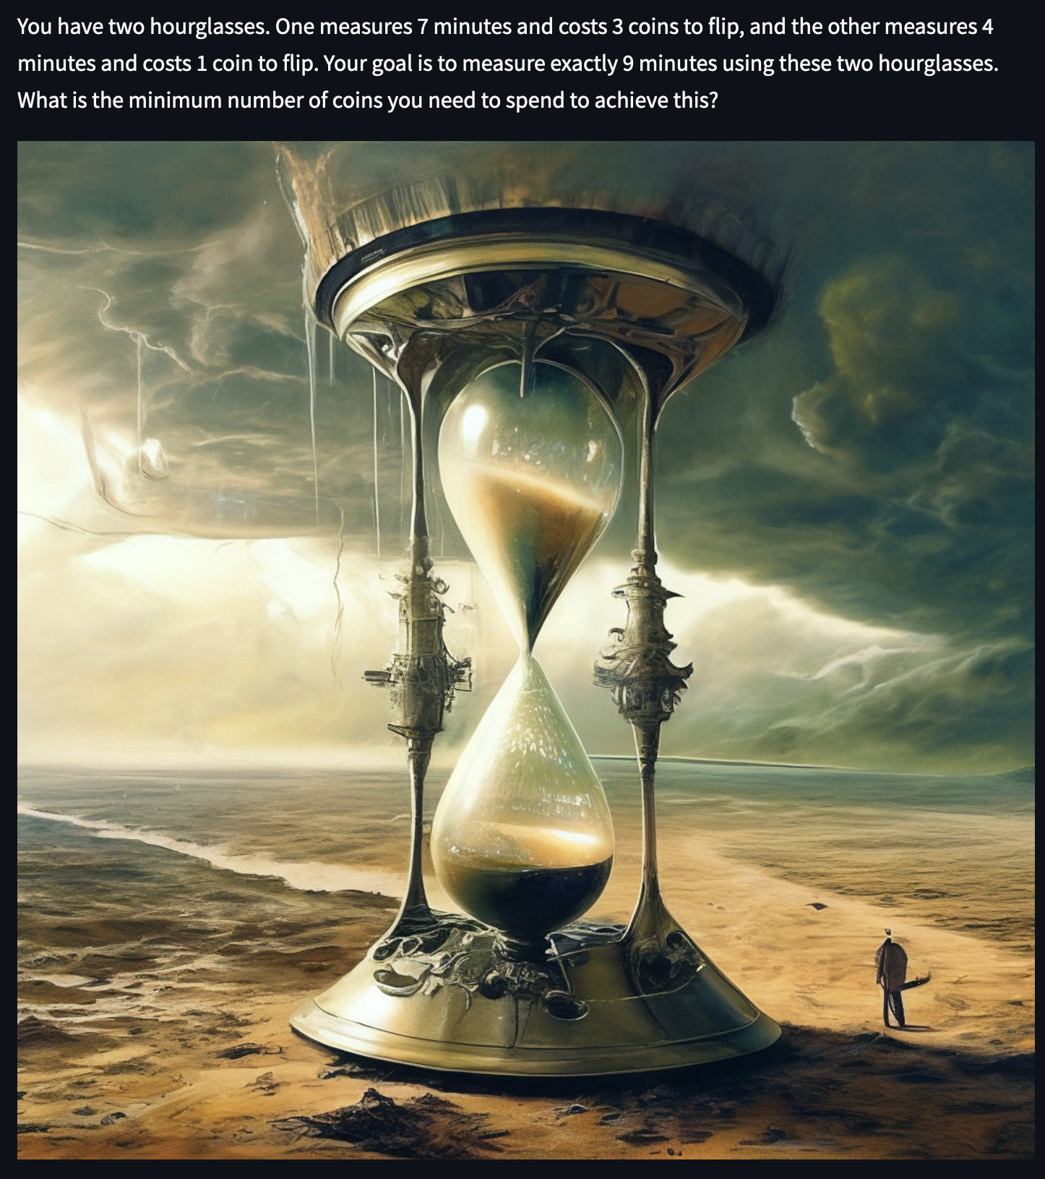
4. Flipping hourglasses
Logic puzzle:
0 minutes : Flip both hourglasses : 4 coins total
4 minutes : Flip 4min hourglass : 5 coins total
7 minutes : Flip 7min hourglass : 8 coins total
8 minutes : Flip 7min hourglass again : 11 coins total
9 minutes : done

Slide 21
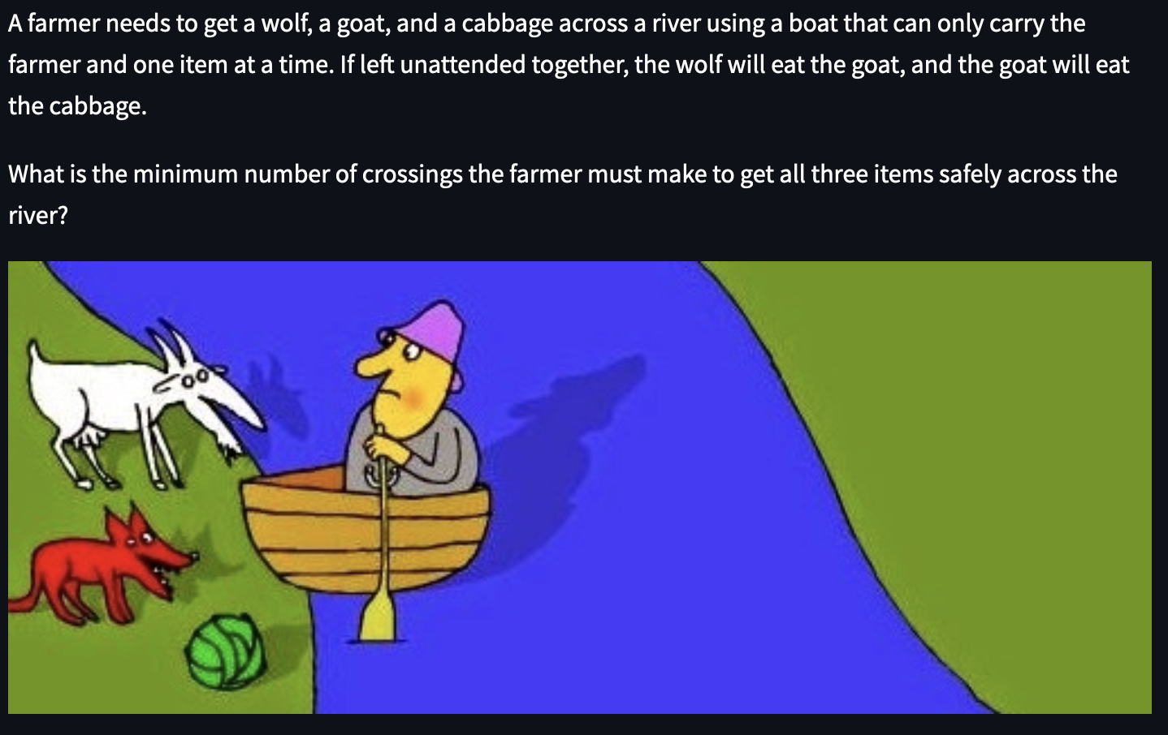
5. A wolf, a goat, and a cabbage
Logic puzzle:
The farmer takes the goat across the river.
The farmer returns alone to the left bank.
The farmer takes the cabbage across the river.
The farmer brings the goat back to the left bank.
The farmer takes the wolf across the river.
The farmer returns alone to the left bank.
The farmer takes the goat across the river again.

Slide 22
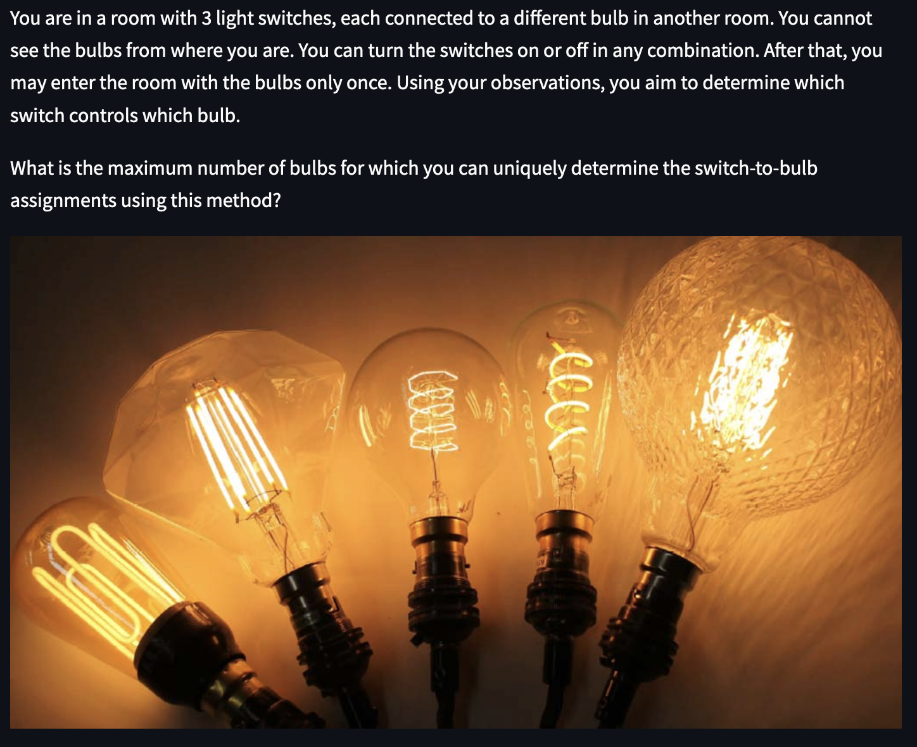
6. Three switches, three bulbs
Logic puzzle:
Turn on switch 1 and leave it on for a few minutes
Turn off switch 1 and turn on switch 2
Go to the room and check:
Warm bulb/electronics : switch 1
Bulb that is on : switch 2
Bulb that is off and cold : switch 3

Slide 23
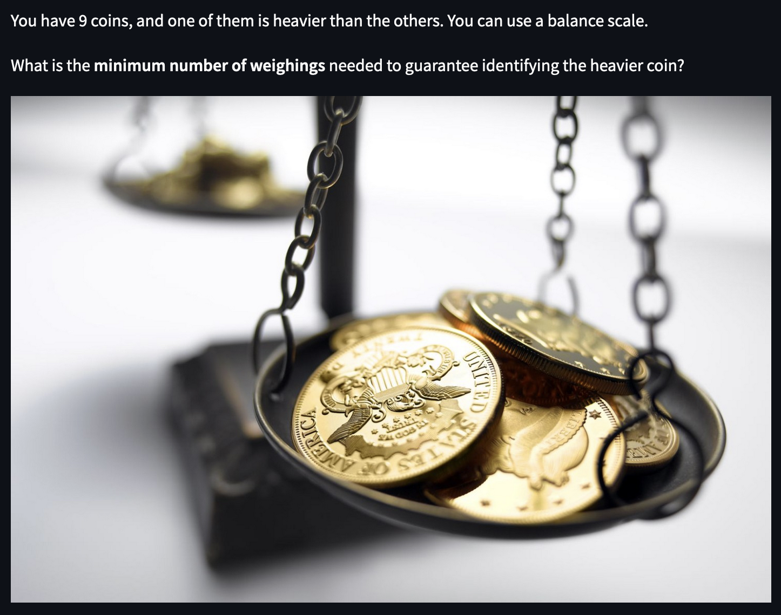
7. Weighing coins
Logic puzzle:
1. Split in groups of three and weight 2 groups
If the groups are equal, the heavier coin is in the not weighed group. Otherwise, it is the heaviest group.
2. Split again in three and weight 2 groups.
If the coins are equal, the heavier coin is the not weighed coin. Otherwise, it is the heaviest coin.

Slide 24
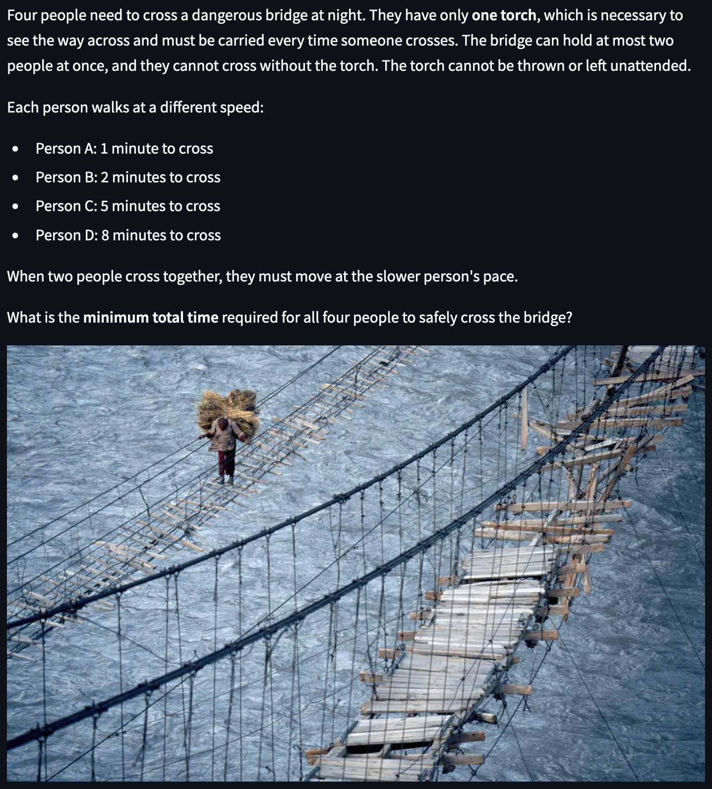
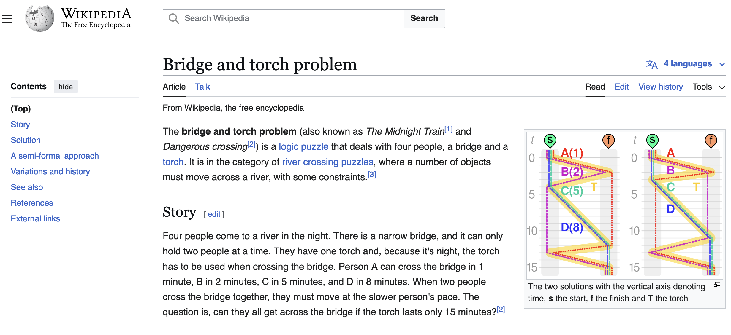
8. Bridge crossings
Bridge and torch problem
Logic puzzle:
A and B cross together : 2 minutes total
A returns with the torch : 3 minutes total
C and D cross together : 11 minutes total
B returns with the torch : 13 minutes total
A and B cross together again : 15 minutes total

Slide 25
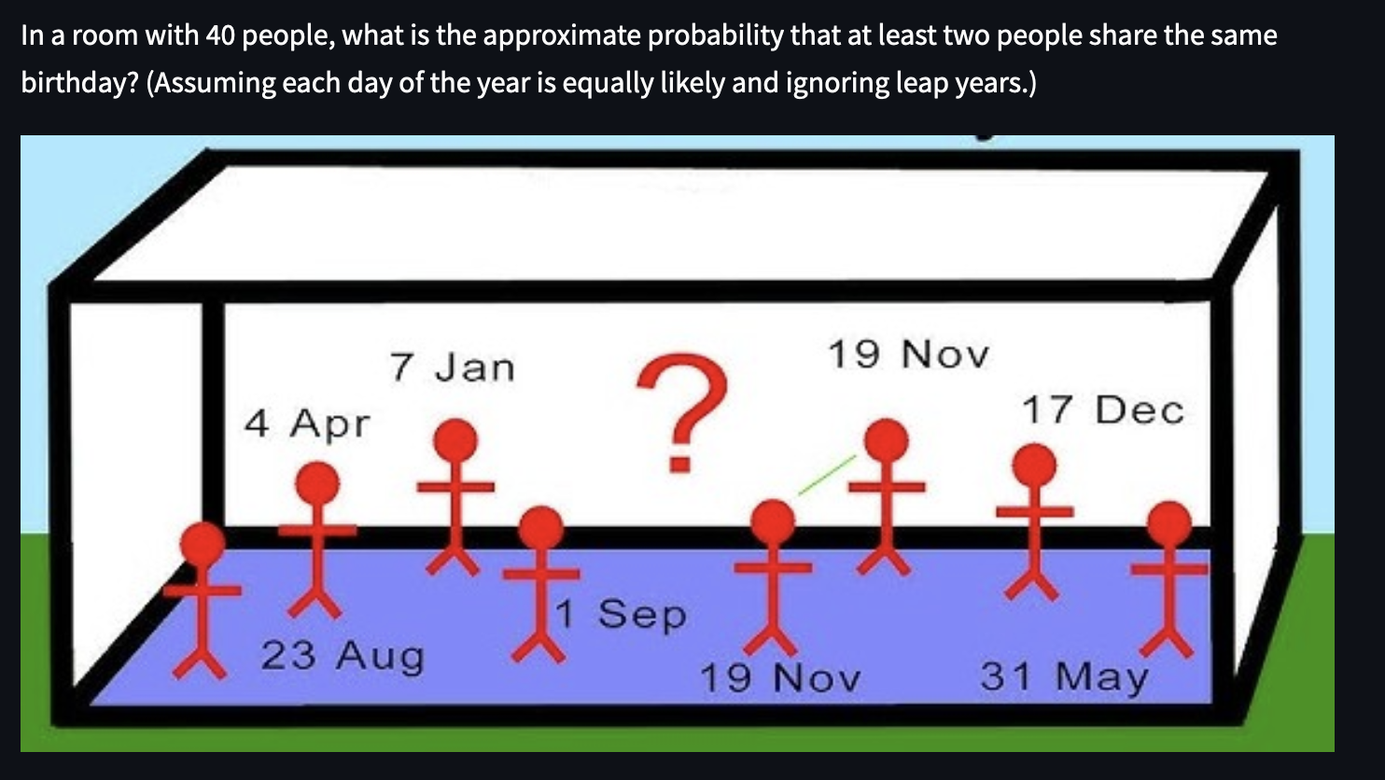
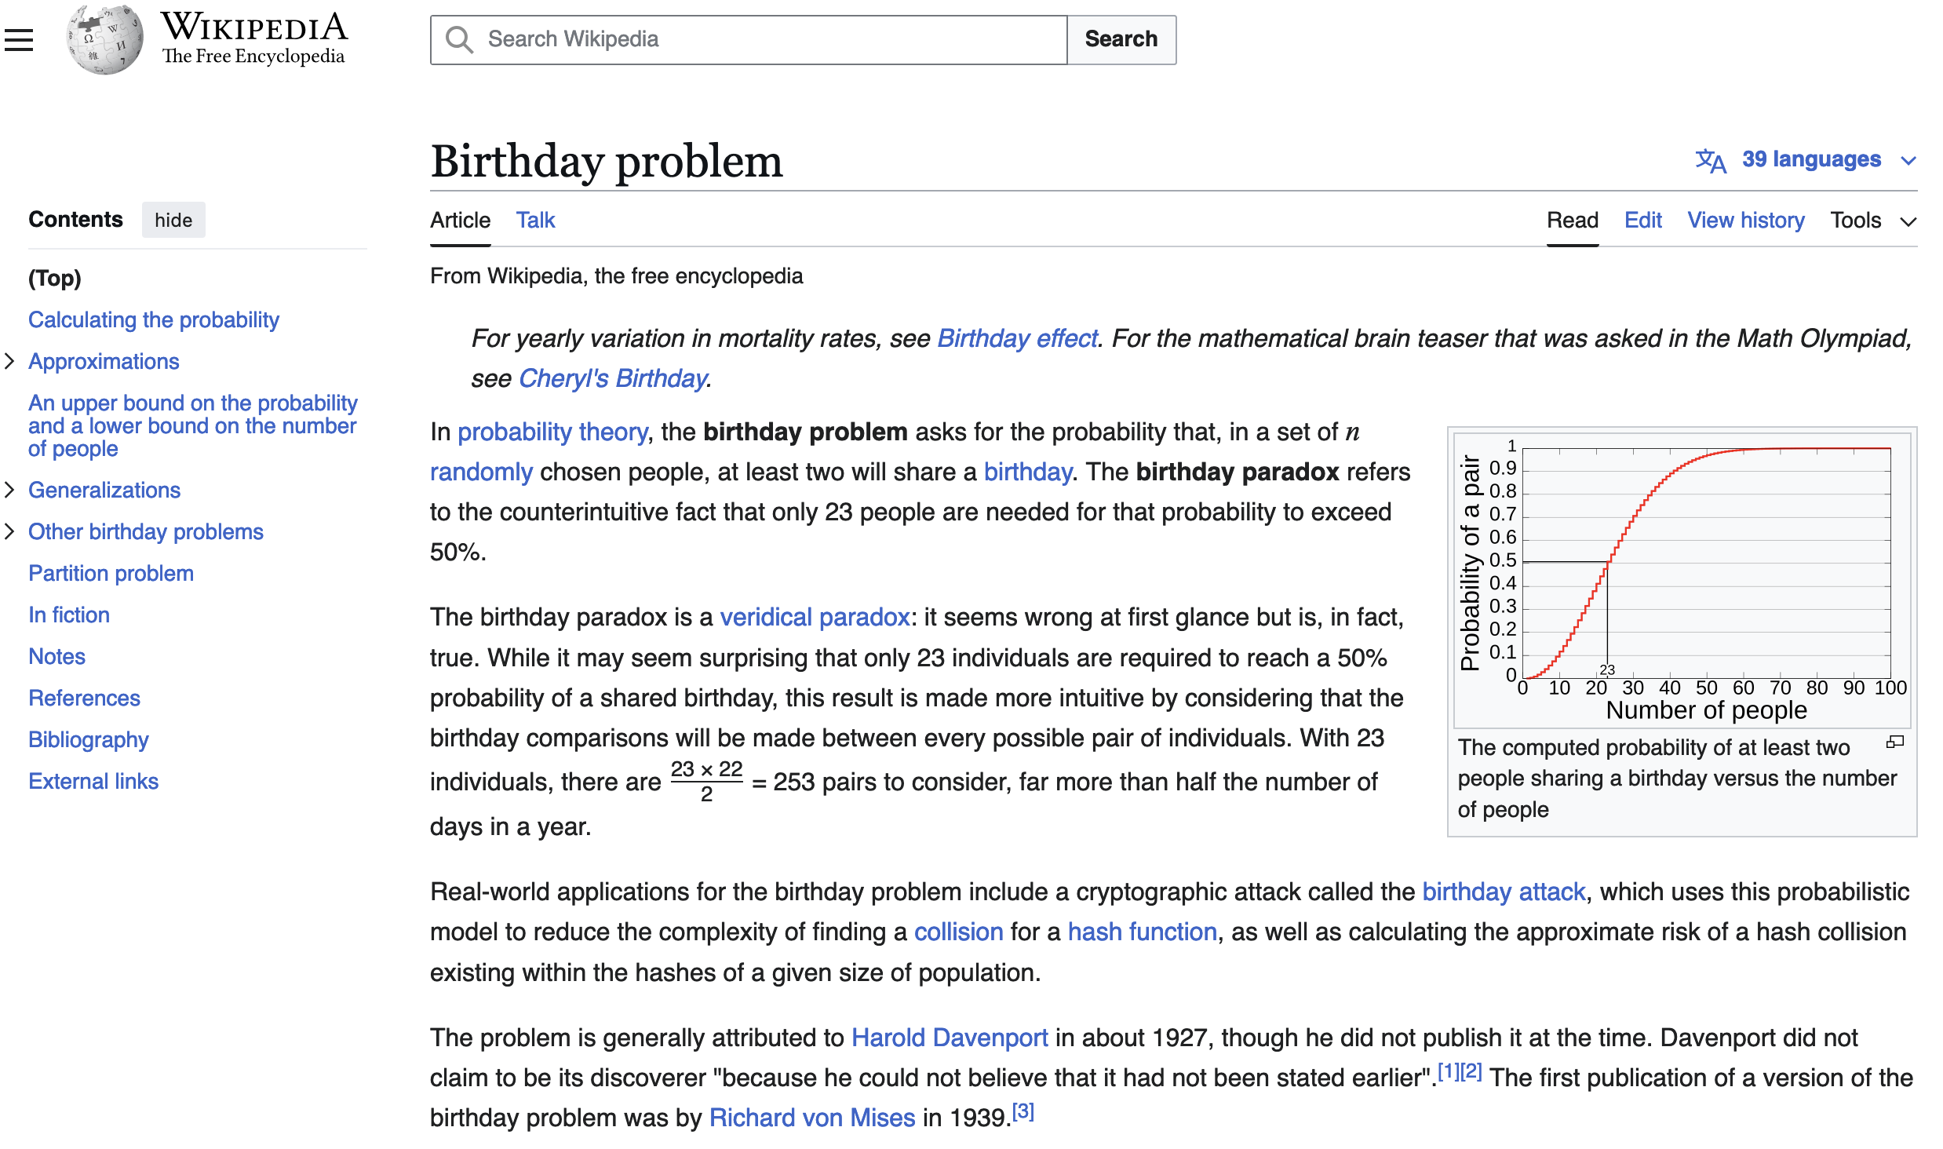
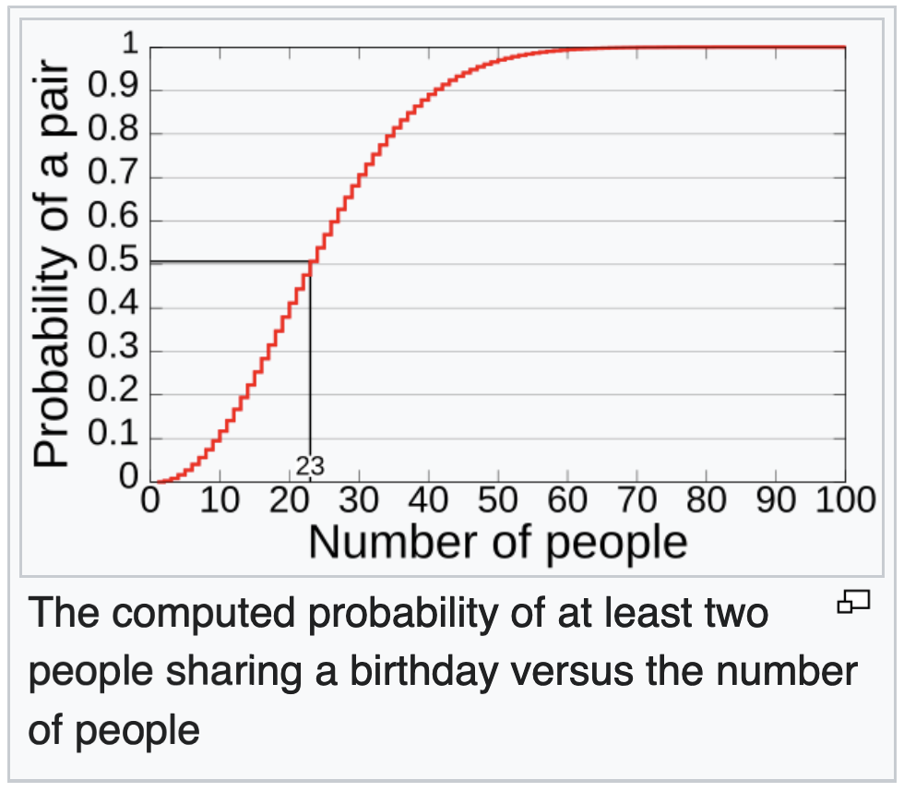
9. Happy birthday to you too
Birthday paradox

Slide 26
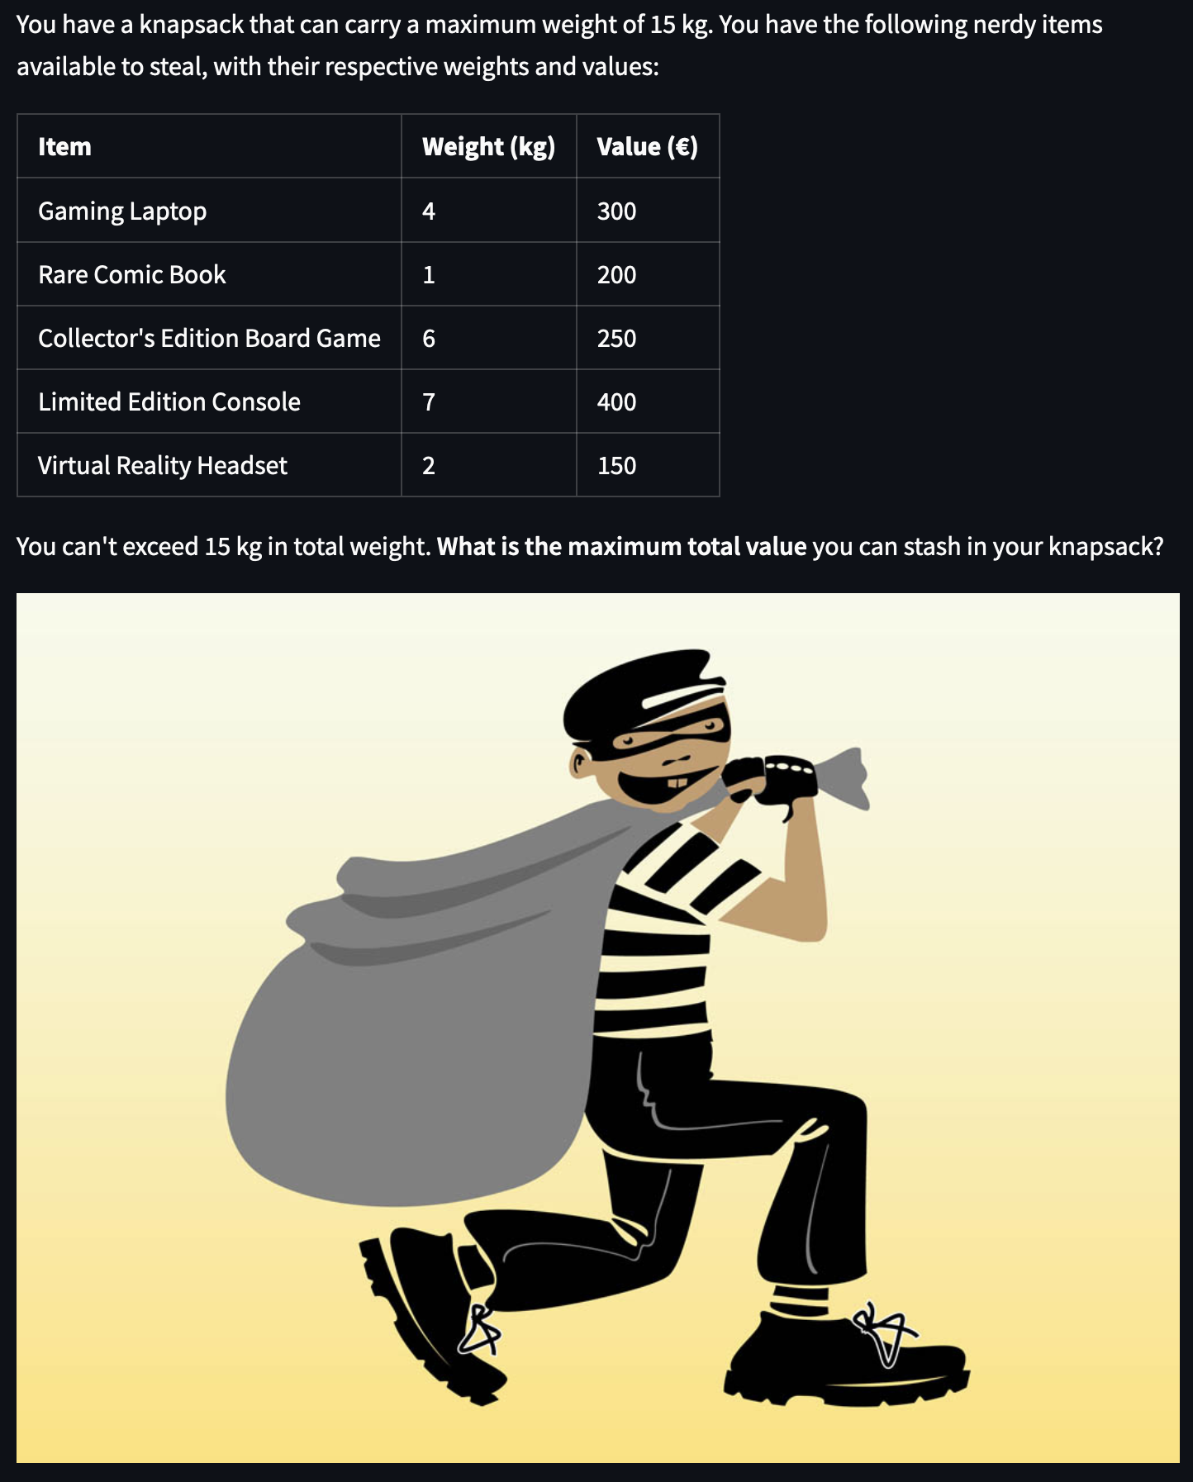
10. Thief and a knapsack
Optimal combination:
By selecting items 1, 2, 4, and 5, you maximize the total value to €1,050 without exceeding the 15 kg weight limit.

Slide 27
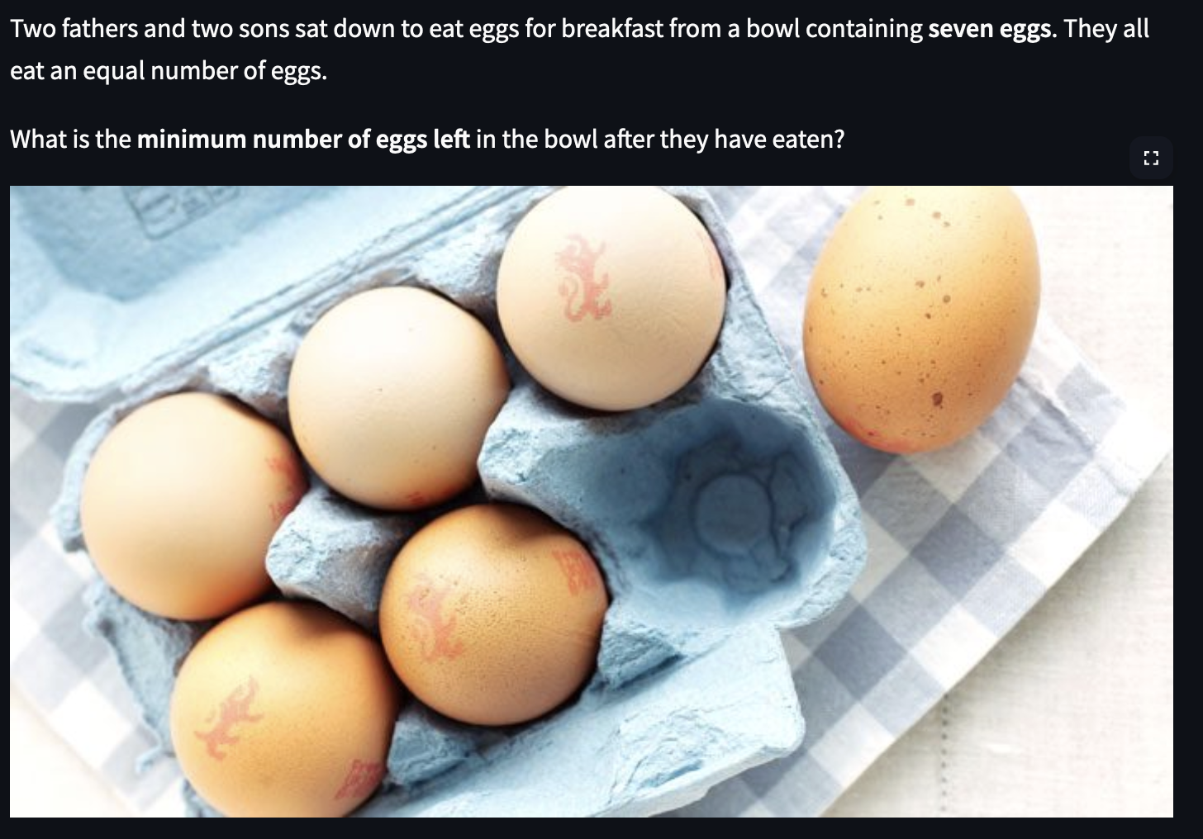
11. Two fathers and two sons
Trick question:
You must realize that two fathers and two sons can be three persons. If they alle eat 2 eggs, there is 1 egg left.

Slide 28

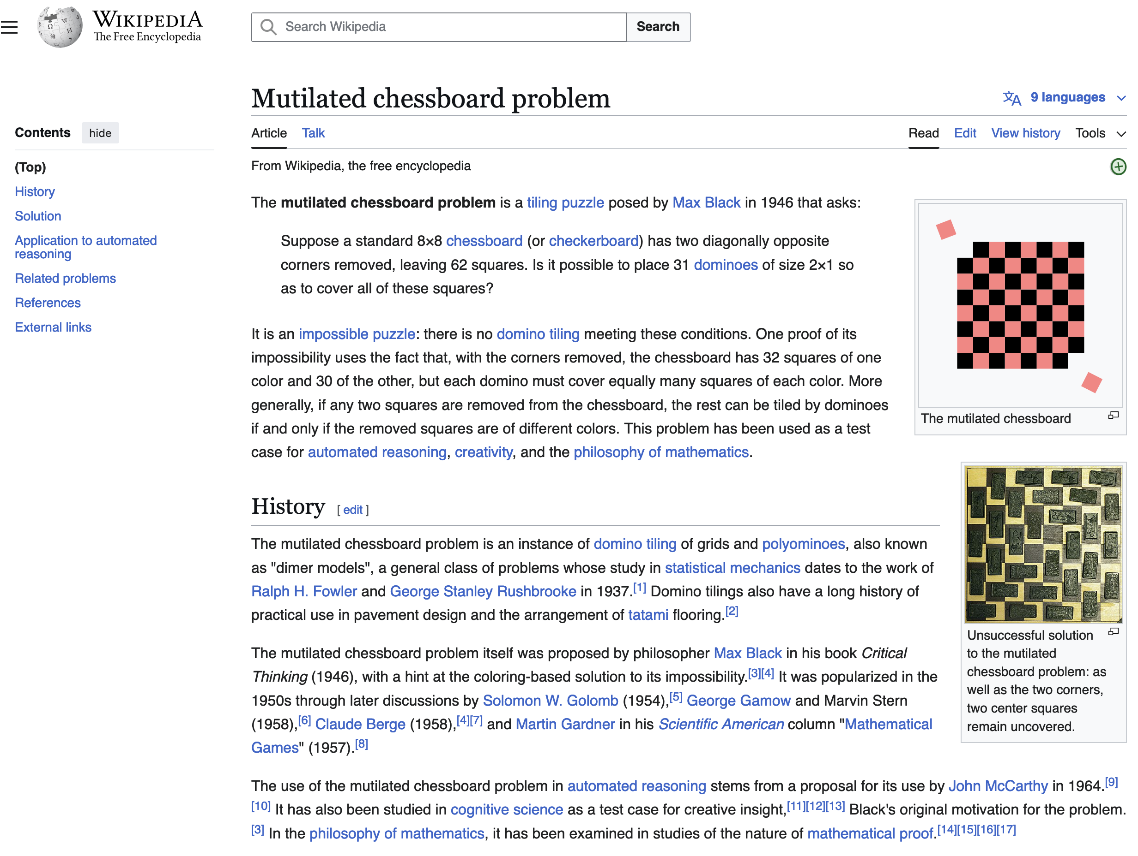
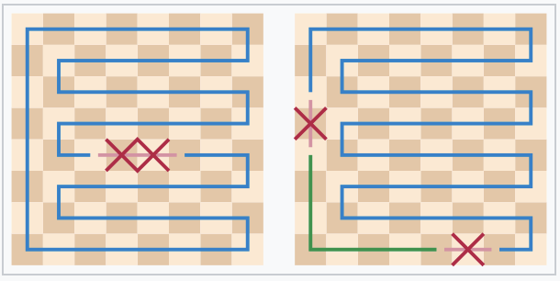
12. Chessboard and dominos
Mutilated chessboard problem
Impossible

Slide 29
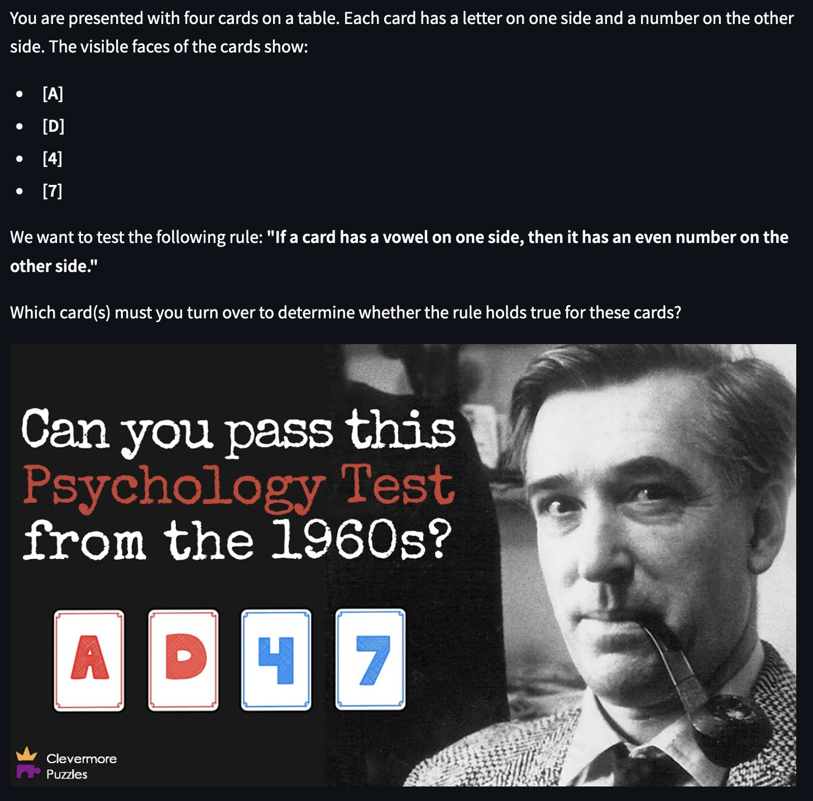
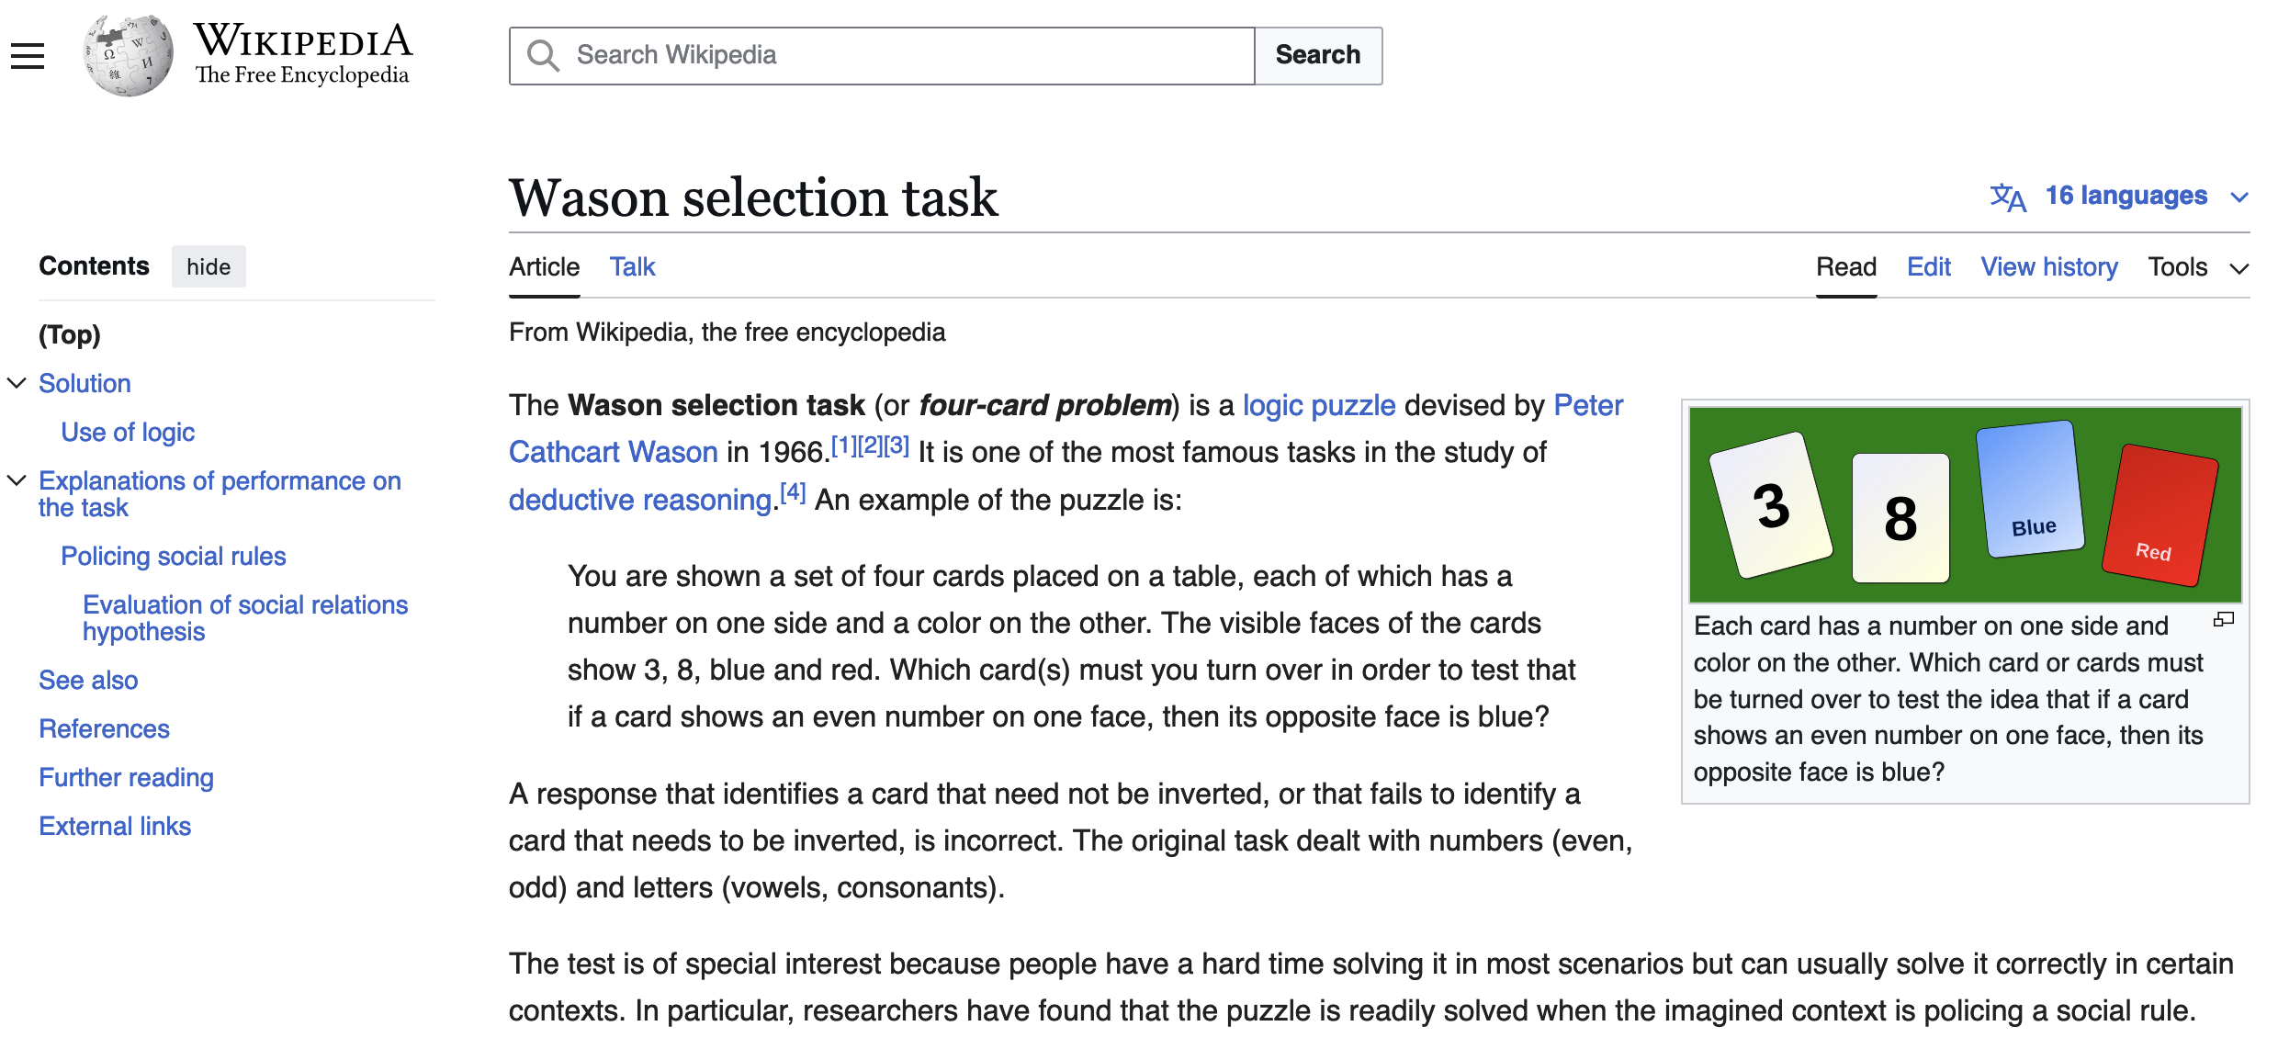
13. Testing assumptions
Wason selection task
The notion here is to check whether the rule has been violated:
We need to check A to see if it has an even number at the back which possibly violates the rule.
We do not need to flip D as we do not care about consonants.
We do not need to flip 4 as the rule does not state that even numbers must have a vowel on the other side.
We need to flip 7 as it could violate the rule. If it has a vowel at the back it would violate the rule.

